Slide 1
Computer Aided Drug Design
Computer aided drug design is a cutting-edge field that combines chemistry, biology, and information technology to revolutionize the drug discovery process. This presentation will explore the history, development, and applications of chemoinformatics in modern drug discovery, highlighting its crucial role in accelerating the identification and optimization of potential drug candidates.
By Israa M Shamkh

Slide 2
Introduction to Chemoinformatics
Definition
Key Components
Chemoinformatics is the application of informatics methods to solve chemical problems, particularly in drug discovery.
It involves the design, creation, organization, management, retrieval, analysis, dissemination, and visualization of chemical information.
Industry Impact
Chemoinformatics has become a critical part of the drug discovery process, transforming data into knowledge for better decision-making.

Slide 3
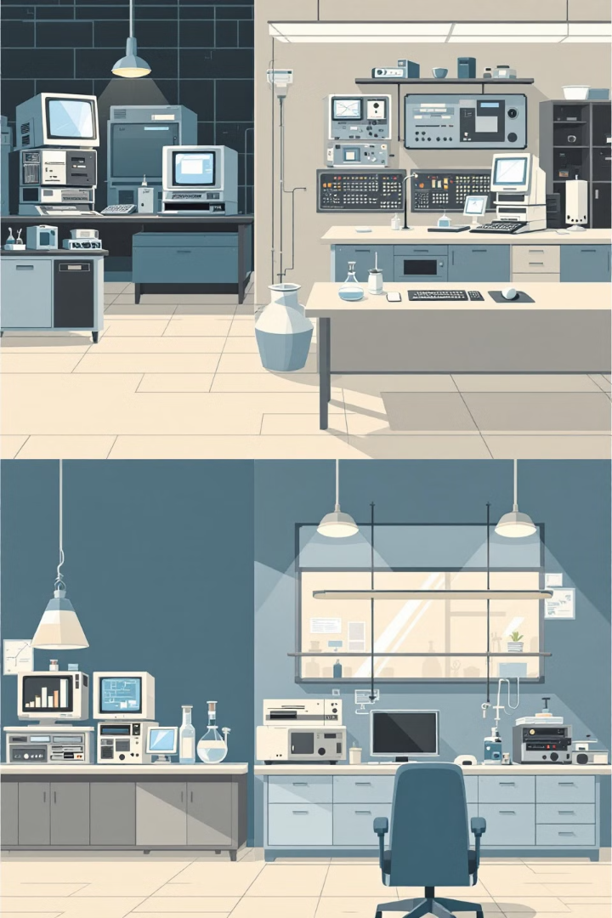
History of Chemoinformatics
1
Mid-1970s
Chemistry and information management begin to intertwine, applied to protein structure prediction and X-ray crystallography analysis.
2
Early 1980s
Computer technology becomes a core component for medical chemists in solving chemical problems.
3
Late 1990s
The term "chemoinformatics" is coined and defined by experts like F.K. Brown and G. Paris.

Slide 4
Role of Chemoinformatics in Drug Discovery
Data Management
Lead Discovery
Lead Optimization
Effectively collects, organizes, and analyzes vast amounts of chemical data generated in drug discovery processes.
Aids in identifying potential drug candidates from large databases of chemical compounds.
Assists in refining and improving the properties of promising drug candidates.

Slide 5
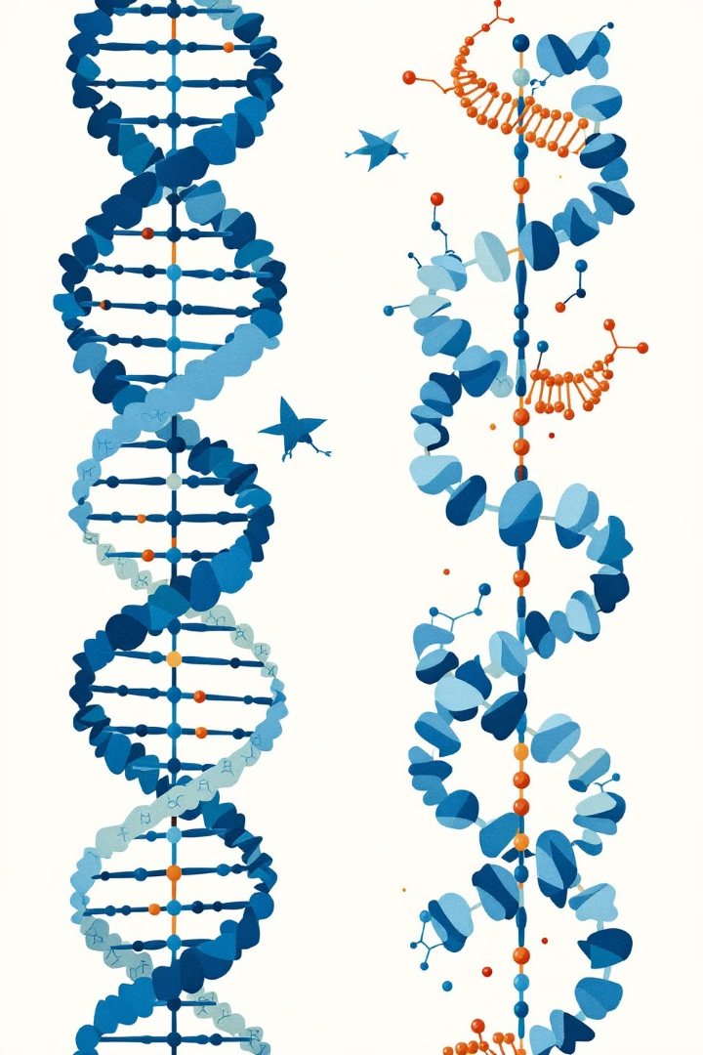
Genetics Review in Drug Discovery
DNA
The genetic blueprint (e.g., TACGCTTCCGGATTCAA)
RNA
Transcribed from DNA (e.g., AUGCGAAGGCCUAAGUU)
Amino Acids
Translated from RNA (e.g., PIRLMQTS)
Protein
Functional molecule formed from amino acids

Slide 6
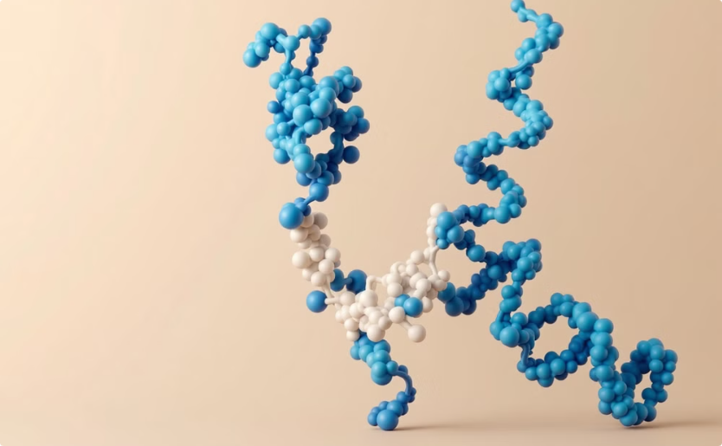
Small Molecule Drug Interaction
Drug-Protein Interaction
Protein Disabling
Illustration of how a small molecule drug interacts with a target protein, potentially disabling it to cure a disease.
Visualization of a protein before and after interaction with a drug, demonstrating how the drug can disable the protein's function.

Slide 7
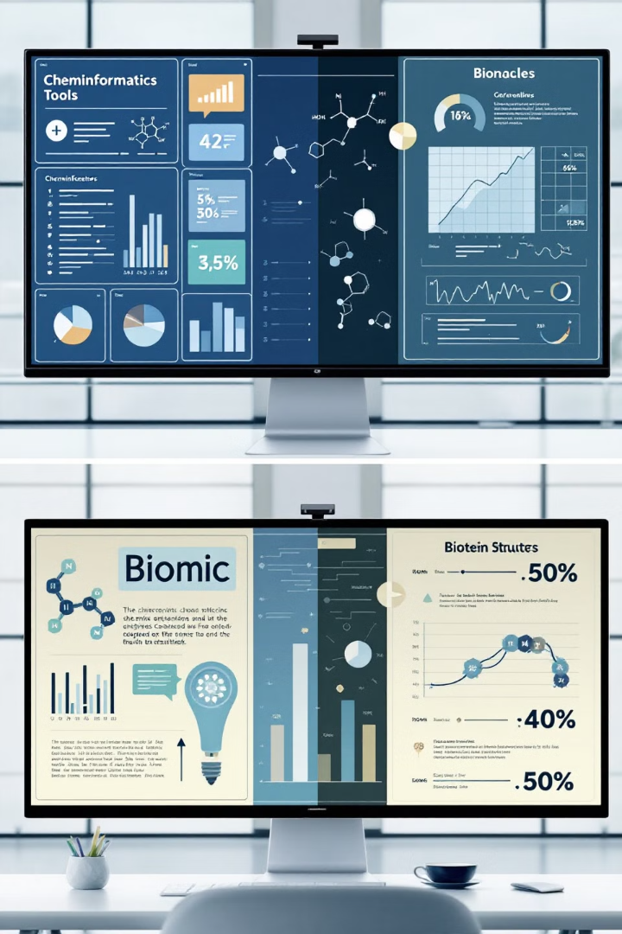
Chemoinformatics vs Bioinformatics
Aspect
Chemoinformatics
Bioinformatics
Focus
Small molecule drugs
Proteins and genes
Database Size
Large
Large
Challenge
Not all can be drugs
Not all can be drug targets
Opportunity
Data mining techniques
Data mining techniques

Slide 8
Information Explosion in Drug Discovery
1
Data Generation
2
Demand for Efficiency
Recent chemical developments are generating vast amounts of data, creating an "information explosion" in drug discovery.
This explosion has created a demand for effective collection, organization, analysis, and application of chemical information.
3
Rapid Development
The goal is to discover molecules that can be rapidly developed for effective treatments to meet medical and agricultural needs.

Slide 9
Early Applications of Chemoinformatics
Protein Structure
X-ray Crystallography
Enzyme Kinetics
Spectroscopy
Prediction of protein structures using computational methods.
Application of Fourier transform techniques to analyze crystal structures.
Computational analysis of enzyme and chemical kinetics.
Analysis of various types of spectroscopy data.

Slide 10
Databases in Chemoinformatics
Cambridge Structural Database (CSD)
Protein Data Bank (PDB)
Collection of crystal structures of small molecules, providing geometrical data on molecular fragments for calibration of force fields and validation of computational chemistry results.
Repository for storing macromolecular data, crucial for understanding protein structures and their interactions with small molecules.

Slide 11
Modern Drug Discovery Process
Disease Selection
1
Identifying the target disease for drug development.
2
Target Identification
Determining the biological target for the drug.
Lead Identification
3
Finding potential drug candidates.
4
Lead Optimization
Refining the properties of promising candidates.
Pre-clinical Trials
5
Testing the drug in laboratory settings.
6
Clinical Trials
Testing the drug in human subjects.
Approval and Marketing
7
Getting regulatory approval and bringing the drug to market.

Slide 12
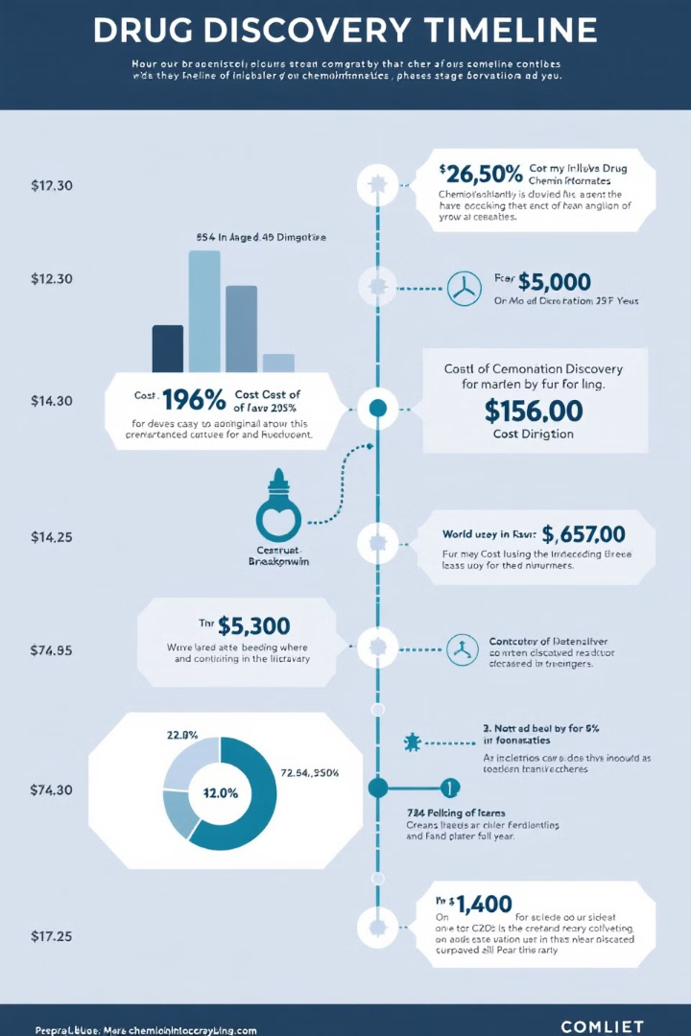
Time and Cost in Drug Discovery
Development Time
Cost
The entire process of drug discovery and development typically takes 10-15 years from initial research to market availability.
The process involves significant financial investment, often in the millions of dollars, particularly in the early stages of molecule identification and preclinical testing.
Role of Chemoinformatics
Chemoinformatics plays a crucial role in reducing both time and cost by streamlining the lead identification and optimization processes.

Slide 13
Wet Lab vs Computational Methods
Wet Lab
Computational Methods
Integrated Approach
Traditional approach involving physical experiments. Time-consuming and costly, especially in molecule synthesis and testing.
Utilizes chemoinformatics to simulate and predict molecular behavior. Faster and more cost-effective for initial screening and optimization.
Modern drug discovery combines both methods, using computational tools to guide and refine wet lab experiments for optimal efficiency.

Slide 14
Future of Chemoinformatics in Drug Discovery
1
AI Integration
2
Big Data Analytics
Increasing use of artificial intelligence and machine learning to enhance predictive capabilities in drug design.
Leveraging vast chemical and biological databases for more comprehensive analysis and insights.
3
Personalized Medicine
4
Virtual Screening
Tailoring drug discovery processes to individual genetic profiles for more effective treatments.
Advanced computational methods for faster and more accurate screening of potential drug candidates.

Slide 15
Conclusion: The Impact of Chemoinformatics
Efficiency
Innovation
Chemoinformatics significantly reduces the time and cost of drug discovery by streamlining the process of lead identification and optimization.
It enables the exploration of vast chemical spaces, leading to more innovative drug candidates.
Precision
Integration
Computational methods allow for more precise predictions of drug efficacy and safety, potentially reducing failure rates in clinical trials.
The field continues to evolve, integrating with other disciplines to create a more holistic approach to drug discovery and development.

Slide 16
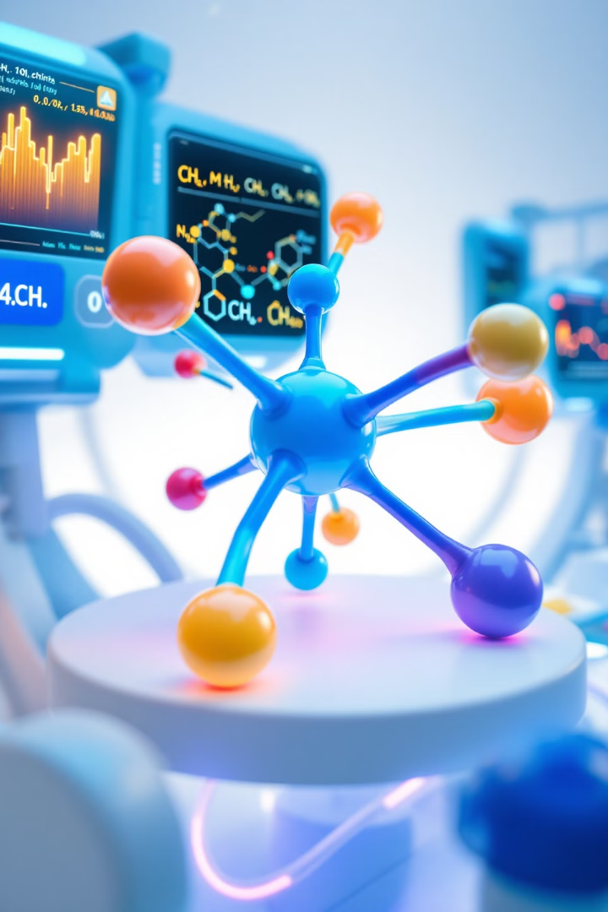
Introduction to Drug Design

Slide 17
Chemoinformatics Defined
Computational Techniques
Virtual Screening
Efficiently analyze large compound libraries.
Applied to chemical problems in drug discovery.
Property Prediction
Data Mining
Forecast molecular characteristics using algorithms.
Extract insights from chemical and biological databases.

Slide 18
Chemical File Formats
SDF
MOL
CIF
PDB
Structure-Data File for multiple molecules.
Stores information for a single molecule.
Crystallographic Information File for structure data.
Protein Data Bank format for macromolecules.

Slide 19
Chemical Databases
PubChem
ZINC
SpiderChem
Extensive database of chemical molecules and activities.
Free database of commercially-available compounds.
Specialized database for novel chemical structures.
ChEMBL
DrugBank
Bioactive molecules with drug-like properties.
Comprehensive resource for drug and drug target information.

Slide 20
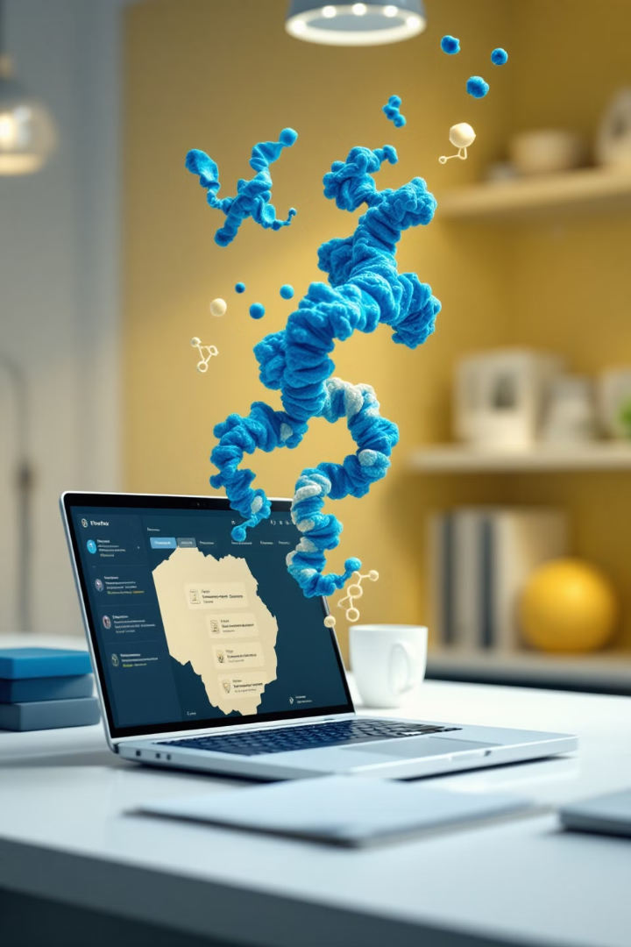
Protein Databases
1
PDB (Protein Data Bank)
3D structural data of proteins and nucleic acids.
2
UniProt
Comprehensive resource for protein sequence and function information.
3
InterPro
Integrated database of protein families, domains, and sites.

Slide 21
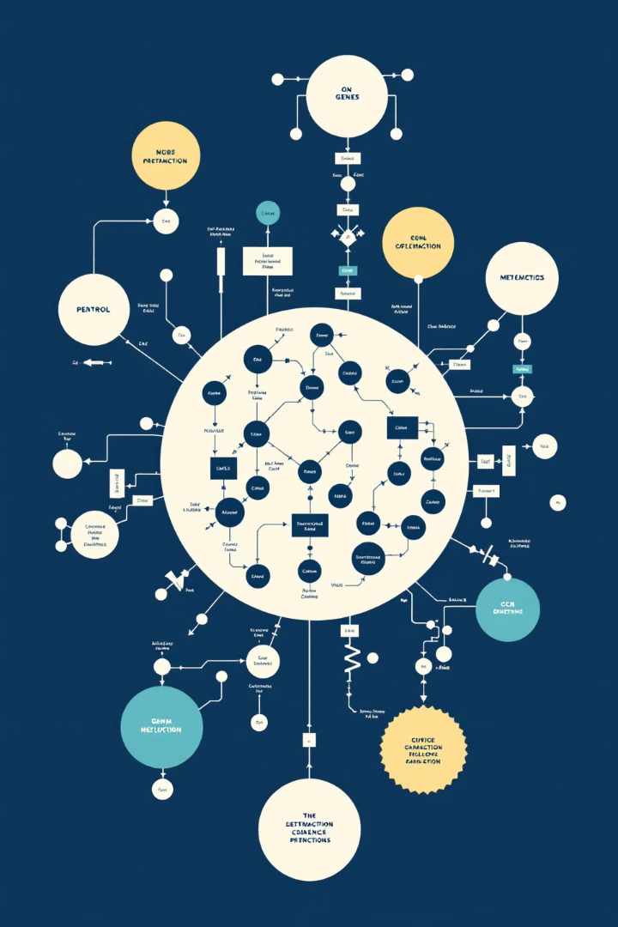
Systems Biology Integration
KEGG Database
Comprehensive resource for understanding complex biological systems.
Pathway Analysis
Integrate molecular interactions into biological pathways.
Network Visualization
Graphical representation of complex biological networks.

